Slide 1
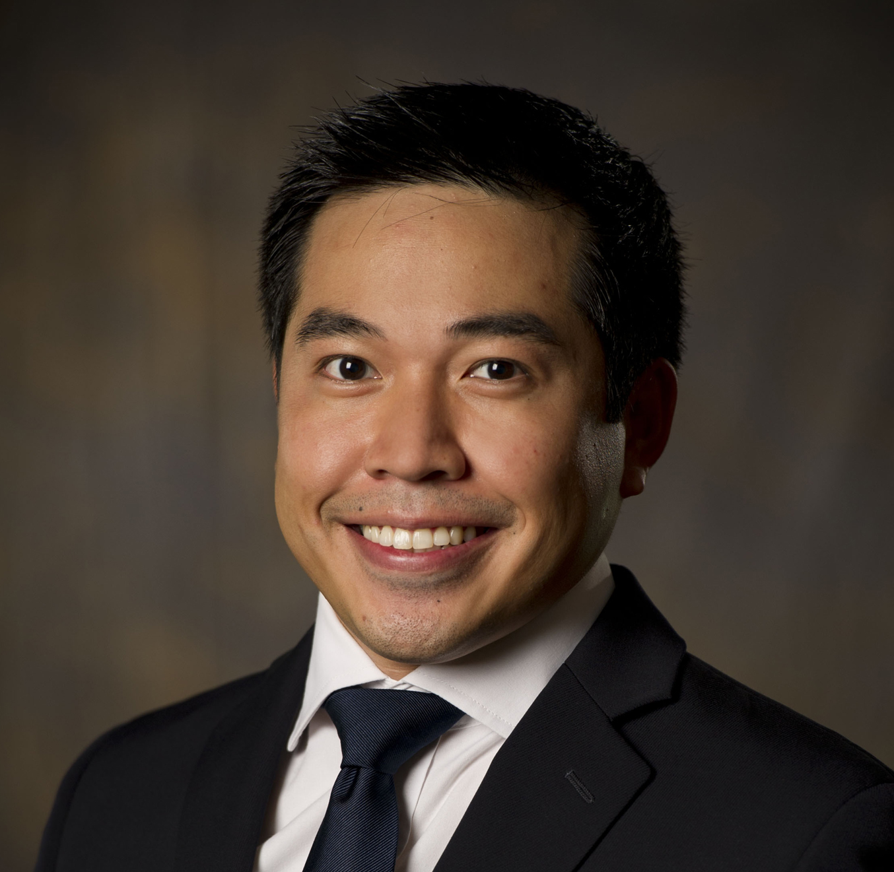
Team Introductions
PwC Professional | Background and Experience
Dominic Mangonon Senior Associate (312) 428-8186 dominic.a.mangonon@pwc.com | Dominic Mangonon is a Senior Associate in the Financial Services Advisory practice. Since joining the firm, Dom has been involved in DOL Fiduciary Rule efforts across a number of clients. Most recently, he completed an impact assessment for a large discount brokerage, where he focused on growth strategies to capture the anticipated money-in-motion resulting from the DOL rule. He also has experience working with enterprise architecture transformations and regulatory change efforts. Prior to joining PwC, Dom has had 5 years of industry experience working for a large global bank where he specialized in client services and operations across several groups and asset classes. Dom received his B.S. in Finance from Rutgers University and holds an MBA from Carnegie Mellon University – Tepper School of Business where he concentrated in Finance, Economics and Information Systems Relevant Experience Conducted a impact assessment for a large discount brokerage, leading a workstream to identify growth opportunities related to the DOL Fiduciary Rule Managed a work stream for a large global banking client, developing business requirement documents (BRDs) to guide the firm during its transformation to a new regulatory reporting platform Provided analysis and built exhibits for a large global investment banking client, used in the structuring of a Resolution Plan or “living will’ required of institutions posing a potential risk to the financial system

